Slide 1

Density Based Traffic Control System
Batch No: B-13 Project Guide:
P. Srujana (164G1A05A4) Dr. C. Sasikala Ph.D.
M. Sireesha (164G1A0597) Associate Professor
P. SreeVidya (164G1A05A3)
N. Umesh Chandra (164G1A05B5)
Srinivasa Ramanujan Institute of Technology
Department of Computer Science & Engineering

Slide 2
Introduction
Traffic Signal Controlling is one of major factor included in the Traffic Management.
Due to inefficient controlling of the traffic controlling systems general public faces many consequences such as traffic jams for long duration, accidents, interruption in social lives.
In order to manage the heavy traffic, signals should be allotted effectively without any inconvenience to the people.

Slide 3
Existing Approaches:
In most of the Indian cities, signal controlling systems are functioning based on the Fixed Time Control Mode or Manual Override Mode.
The limitations of Fixed Time Control Mode is that the waiting time is independent of the severity of traffic.
The limitations of Manual Override Mode is that it is not automated and it is ambiguous to predict the traffic flow.

Slide 4
Proposed System:
The proposed approach is to control the traffic signal based upon the vehicle density i.e., number of vehicles approaching the junction or a signal point.
The traffic signal time in this approach is not static , it varies respective to vehicle density. This will be implemented based upon Open Computer Vision (OpenCV).
Here, the number of vehicles in a lane are identified and compared with the number of vehicles in the adjacent lane.

Slide 5
Abstract
To resolve the traffic congestion and decreasing vehicle queuing by making efficient use of traffic controlling system.
In the proposed method the traffic signal controlling is done by detection of moving vehicles and observing the density of vehicles in a lane by using computer vision.

Slide 6
Methods
Background Subtraction
BGR2GRAY - Gausian Blur – Binary – Dilation
Finding contours
Providing the signal based upon the vehicle density(Count of the vehicles)

Slide 7
Background Substraction
Background subtraction is a popular method for isolating the moving parts of a scene by segmenting it into background and foreground
In many surveillance systems, this method is used to find the background model of an image so that moving objects in the foreground can be detected by simply subtracting the background from the frames.

Slide 8
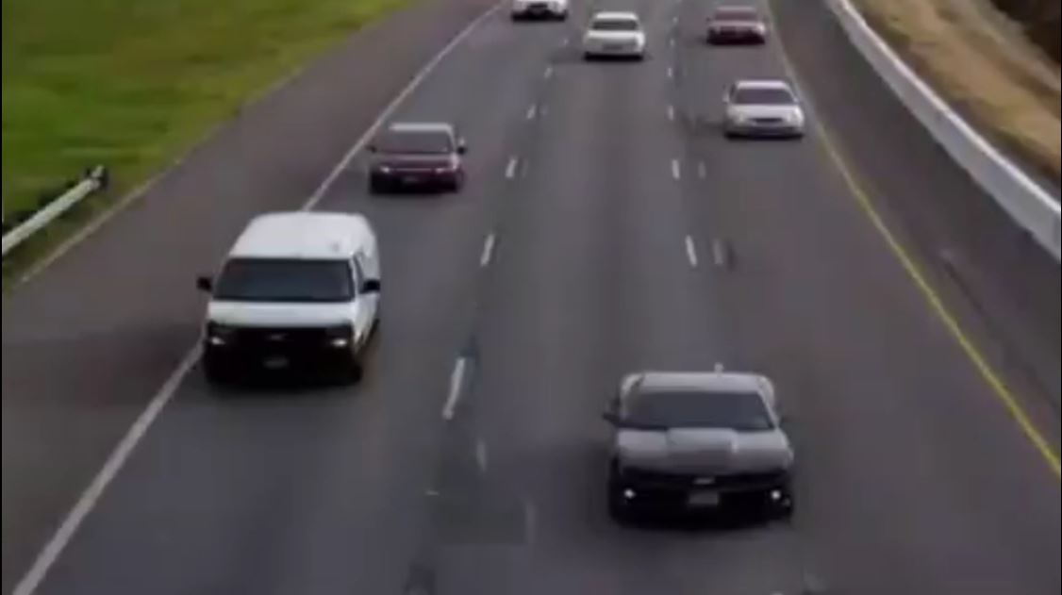
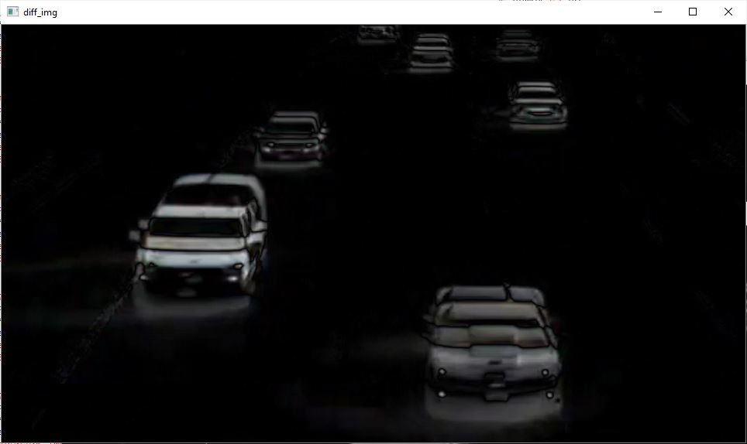
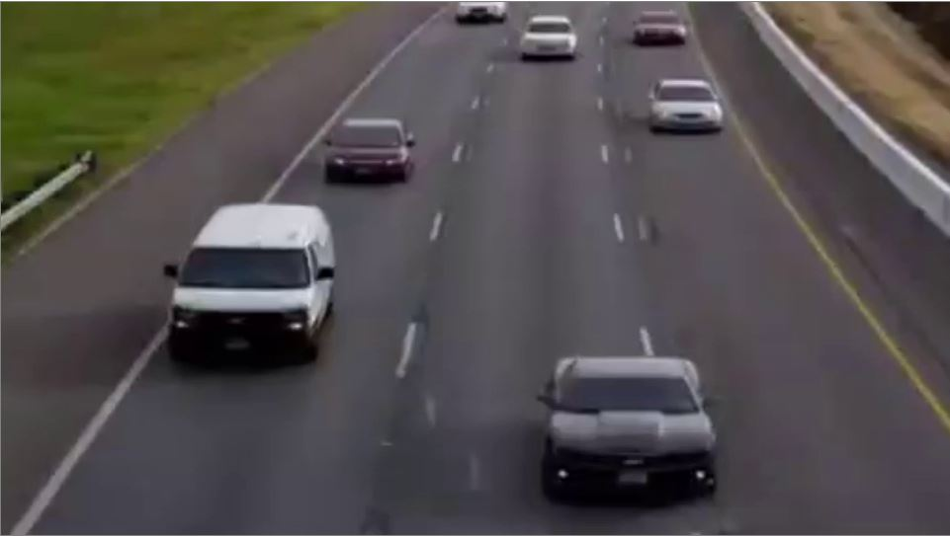
Base image_1
Difference image
abs_diff()
Difference image
Base image_2

Slide 9
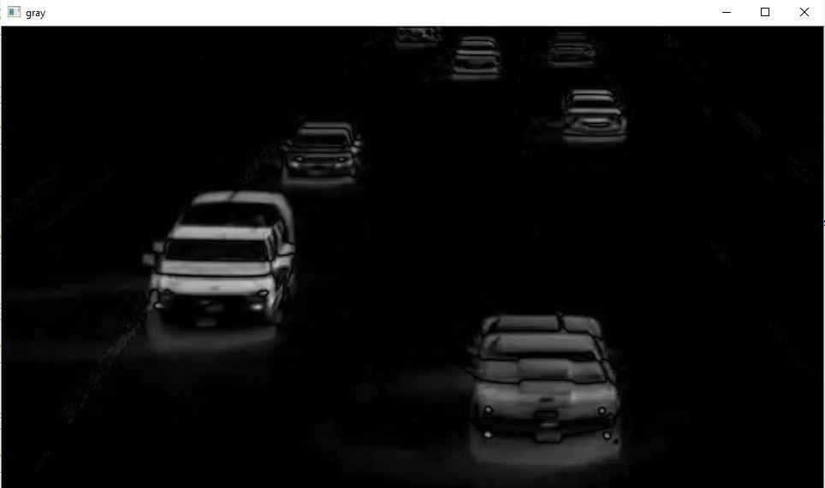
BGR2GRAY
After background substraction, the output frame is converted to gray image.
Difference image
gray()

Slide 10
Gaussian Blur – Binary – Dilation
Gaussian Blur is applied to the resultant gray image which is converted to binary image based up on the threshold value.
Finally, dilation operation is performed which helps to generate the contours.

Slide 11
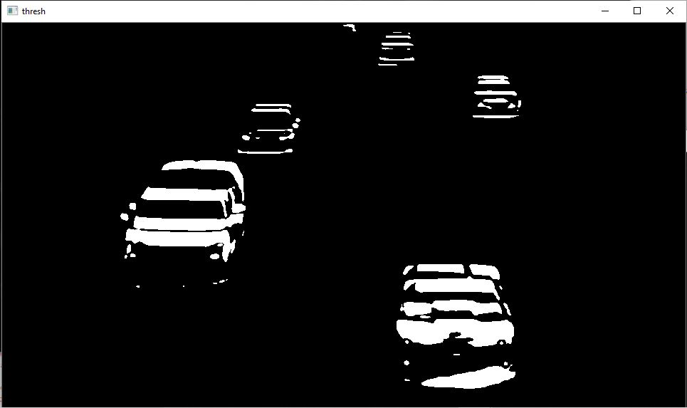
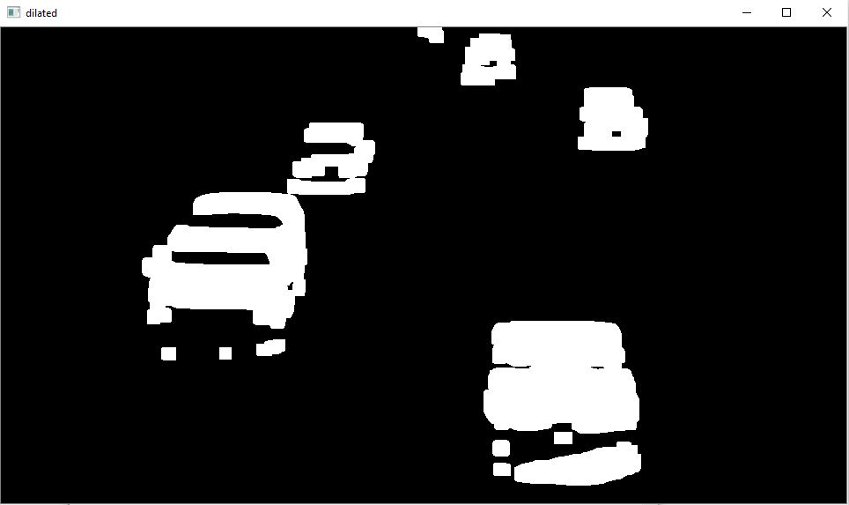
binary()
Gray image
dilation()
Binary image
Dilated image

Slide 12
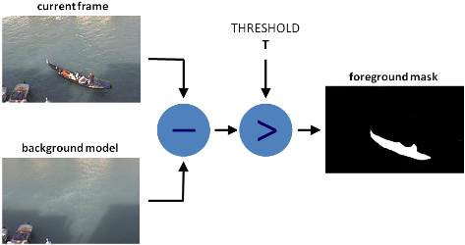

Slide 13
Finding Contours
From the obtained dilated image respective contours are generated for the concentrated areas.
Generating contours for the moving objects helps in detection and tracking in real time.

Slide 14
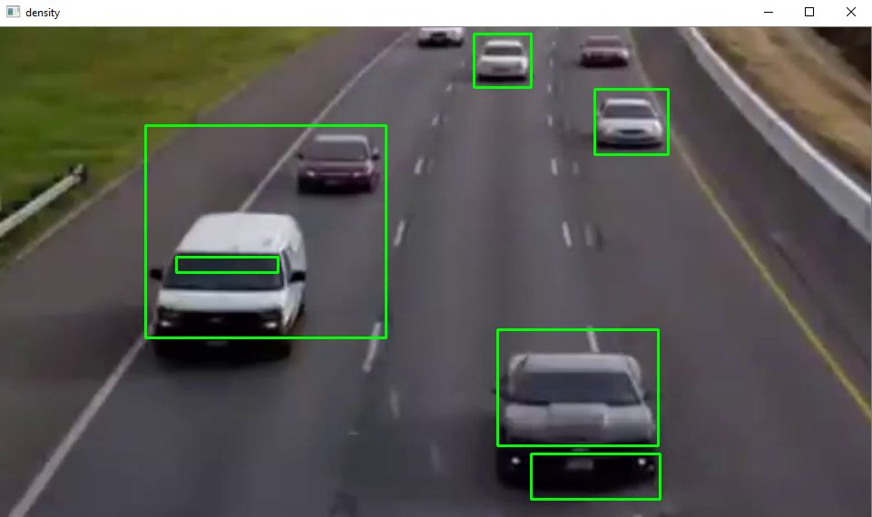
Contour image
Contours generated for a single frame can be illustrated from the above figure.

Slide 15
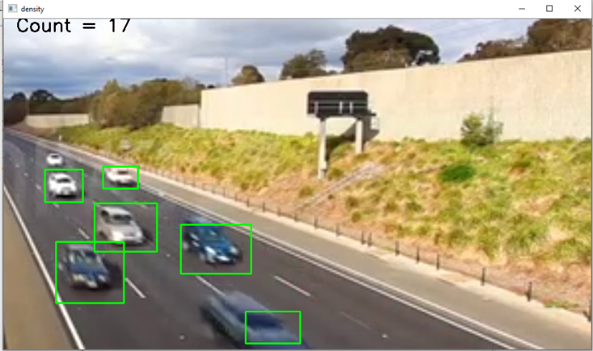
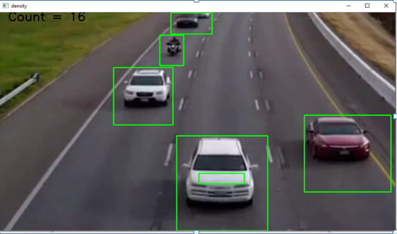
OUTPUT
Lane 1
Lane 2

Slide 16
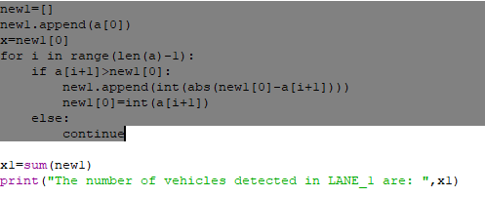

Slide 17
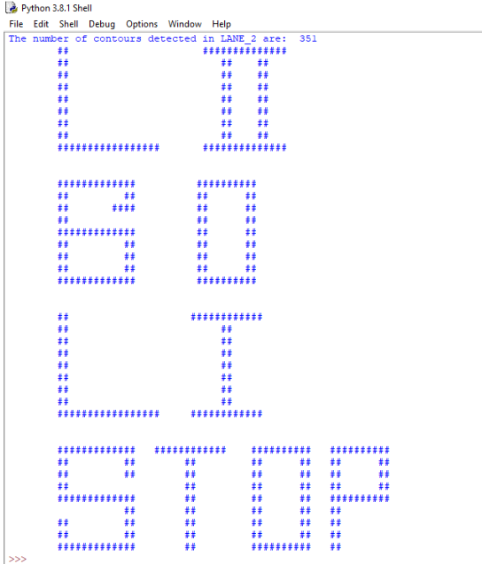

Cont

Slide 18
Conclusion
This project formally introduces the necessity for the development in traffic management.
The main purpose of this project is to describe the importance of automation in traffic controlling and traffic management.
The Future scope of the system is to build more sophisticated system that not only helps to track down the moving objects but also to dynamically change itself to extreme situations

Slide 19
References
[1] Seenouvong, Nilakorn, et al. "A computer vision based vehicle detection and counting system." 2016 8th International Conference on Knowledge and Smart Technology (KST). IEEE, 2016.
[2] Tahmid, Taqi, and Eklas Hossain. "Density based smart traffic control system using canny edge detection algorithm for congregating traffic information." 2017 3rd International Conference on Electrical Information and Communication Technology (EICT). IEEE, 2017.
[3] Fratama, Rizki Ramadhan, et al. "Real-Time Multiple Vehicle Counter using Background Subtraction for Traffic Monitoring System." 2019 International Seminar on Application for Technology of Information and Communication (iSemantic). IEEE, 2019.

Slide 20
Thank you
Queries
?

